Slide 1
SATELLITE ORBIT SIMULATION
Speaker : Soumy Ladha
Supervisor : Prof. Susmita Bhattacharyya

Slide 2
OBJECTIVE AND MOTIVATION
OBJECTIVE
Realistic simulation of Earth Orbiting Satellite Motion
MOTIVATION
Validation of advance algorithms to be used onboard satellites (e.g. GPS Receiver algorithms)
Better understanding of satellite motion

Slide 3
Project Roadmap
Background Study
Simulation of satellite motion
Inputs: Orbital elements in International Celestial Reference Frame (ICRF)
Outputs: Satellite Position, Velocity, Acceleration and Jerk (PVAJ) in International Terrestrial Reference Frame (ITRF)
MATLAB implementation of algorithms

Slide 4
Background Study
Time
Universal Time (UT1)
Terrestrial Time (TT)
International Atomic Time (TAI)
Coordinated Universal Time (UTC)
Julian Day
Reference Systems (ICRF and ITRF)
Coordinate Transformation from ICRF to ITRF
Precession
Nutation
Earth Rotation And Polar Motion

Slide 5
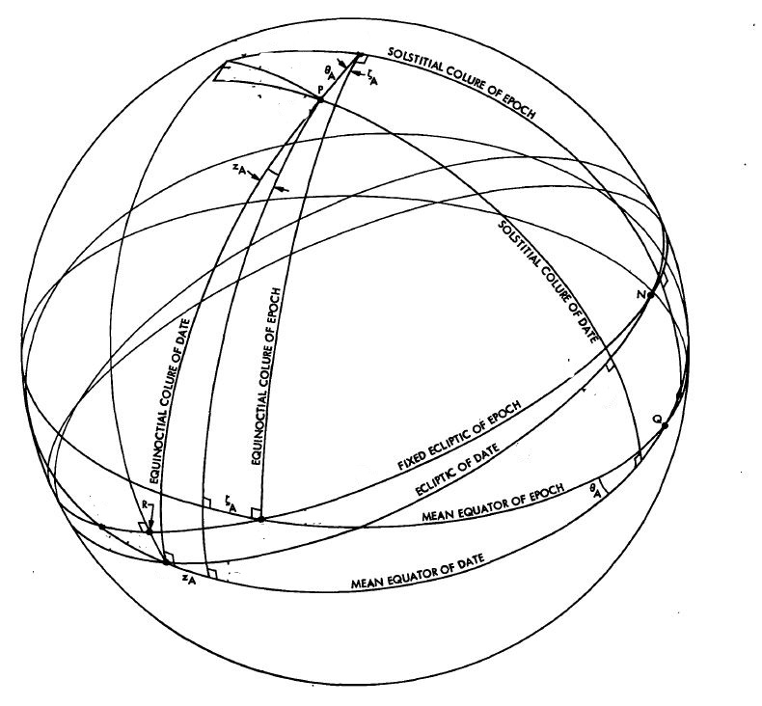
Precession
Coordinate transformation from Mean Equator of Epoch to Mean Equator of Date

Slide 6
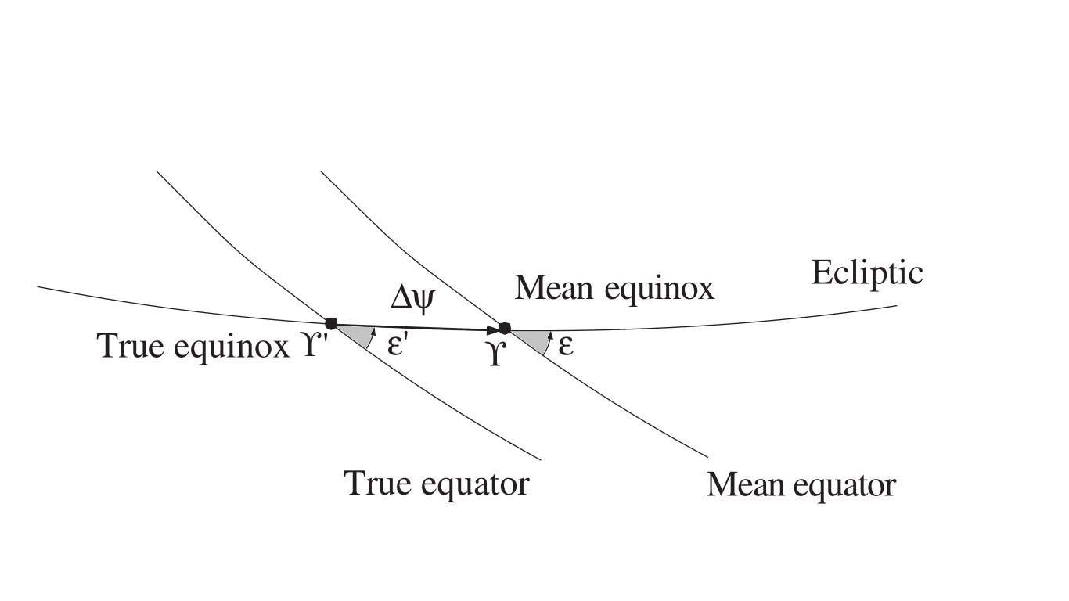
Nutation Coordinate transformation from Mean equator of epoch to true equator of epoch

Slide 7
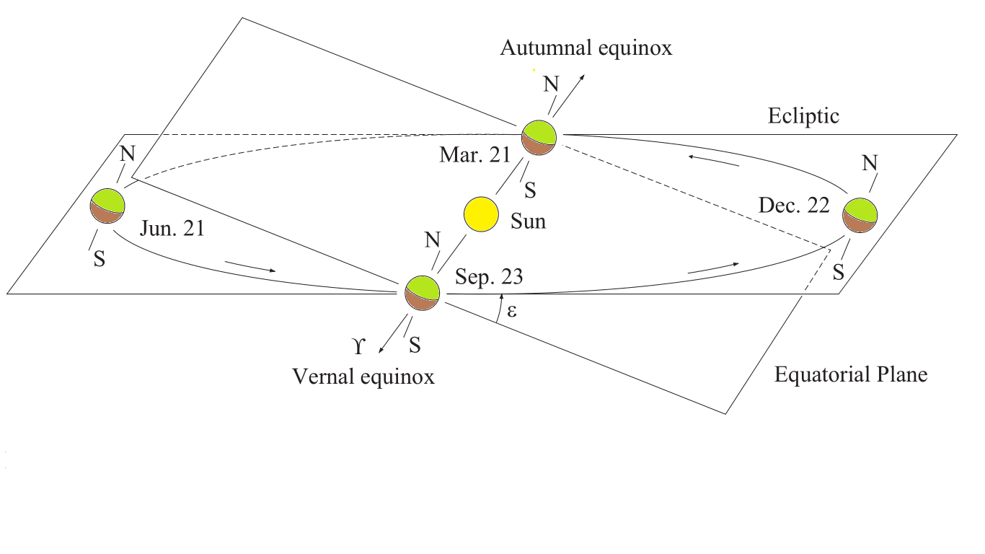
Earth Rotation

Slide 8
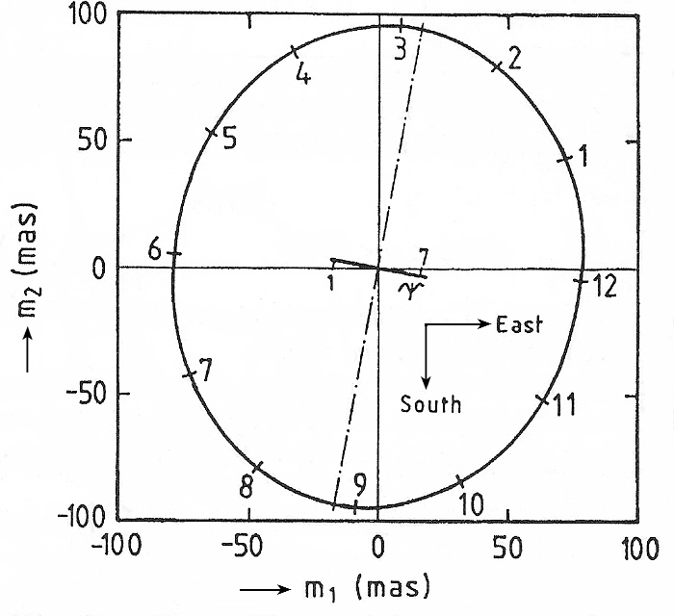
Polar Motion Coordinate transformation from CEP to ITRF

Slide 9
Simulation of Nominal orbits
Earth Centred Interial (ECI)
Inputs
Semi-major axis
Eccentricity
Inclination
Right ascension of ascending node
Argument of perigee
Mean anomaly
Outputs
Position
Velocity
Acceleration
Jerk

Slide 10
Implementation
Position, Velocity, Acceleration and Jerk are calculated in ECI frame(J2000)
Using Julian Date, Delta UT1 calculate Precession matrix, Nutation matrix, Earth Rotation matrix and Polar motion
Calculate coordinate Transformation matrix and its Derivatives
Calculate position, velocity, acceleration and jerk.
Compare results with previously calculated ECEF
Notes:
10

Slide 11
Coding Standard
%*************************************************************************
% The following function calculates the Eccentric anomaly from Mean Anomaly
% Function Arguments : ecc = Eccentricity
% mean_anom = Mean Anomaly
% Functions Outputs : Ecc_anom = Eccentric Anomaly
% Library calls : NIL
% Global Variables : NIL
% Version History:
% <1.1> <Soumy Ladha>
%*************************************************************************
function Ecc_anom = EccenAnom(ecc,mean_anom)
Ecc_anom=0;
temp=mean_anom;
for i = 1:7
% The method has been extracted ...
% Page no 24 ,Eqn no 2.42
Ecc_anom=temp;
temp=Ecc_anom-(Ecc_anom-ecc*sin(Ecc_anom)-mean_anom)/(1-ecc*cos(Ecc_anom));
end

Slide 12
Results
Eccentricity = 0.7079772
Orbital Inclination = 6.971
Semi Major Axis = 25015181
Right Ascension of Ascending Node = 173.290
Argument of Perigee = 91.553
Mean Anomaly = 144.225

Slide 13
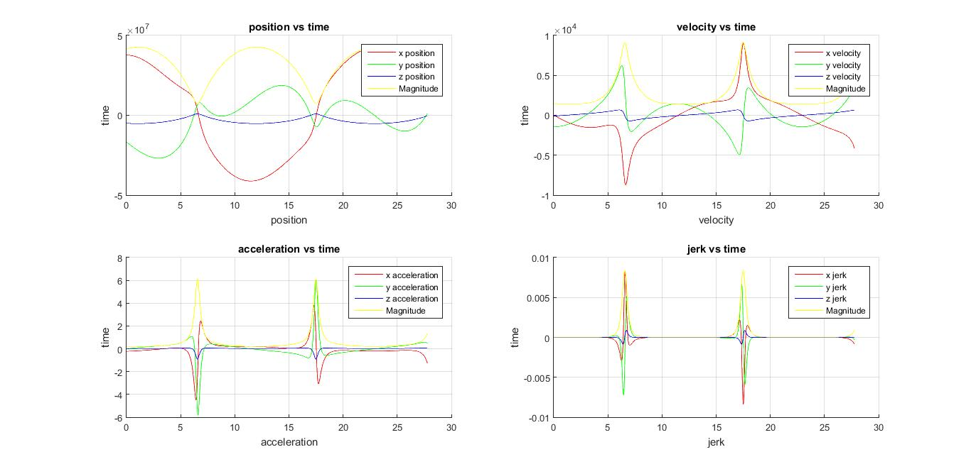
PVAJ in ECEF

Slide 14
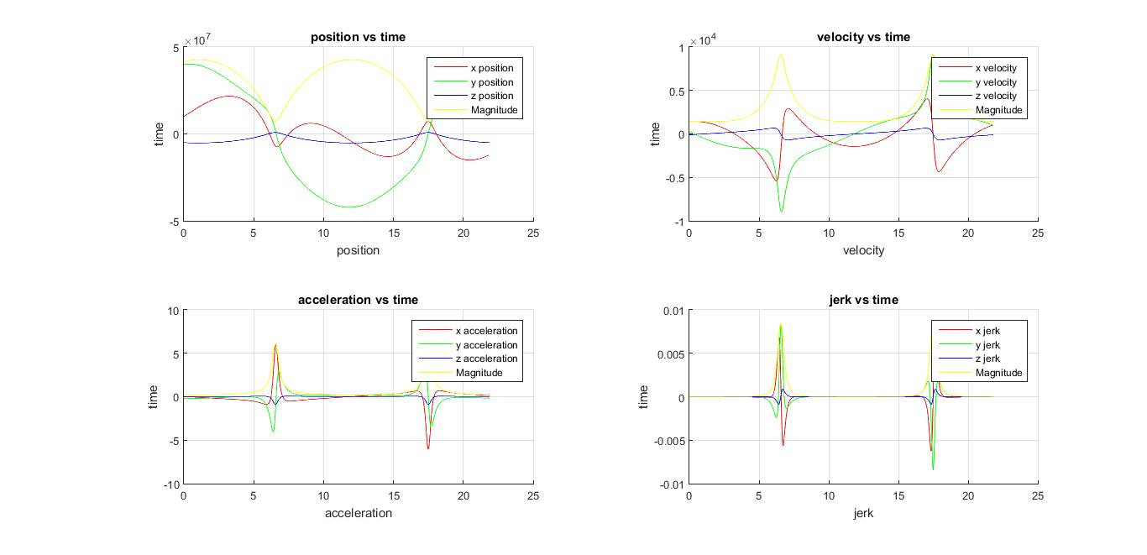
PVAJ in ICRF

Slide 15
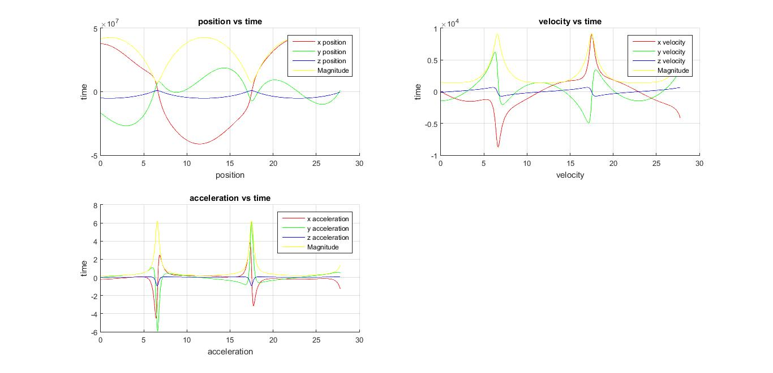
PVAJ Calculated Numerically

Slide 16
Conclusion
Simulation of orbit has been done
ECI frame which includes implementation of precession, nutation, earth rotation and polar motion.
Validation of result using two different independent methods.

